Slide 1

We Put the “UN” in “FUN”: The Mathematical Guide to Saving the World
Elizabeth Cutting, Madison Jones, and Erick White
University of Colorado Boulder

Slide 2

Problem
•UN Sustainability Goals: 17 goals aimed at sustainable future development
Create a network of relationships between the 17 SDGs
•Create priorities to efficiently move the UN’s goals forward
•Demonstrate the impacts of goals on each other
•Discuss the impacts of technological advancements, global pandemics, climate change, regional wars, and refugee movements on the 17 SDGS
This Photo by Unknown Author is licensed under CC BY-SA
Notes:
Madison
In 2015 UN adopted 2030 Agenda for Sustainable Development
This led to the creation of the 17 sustainable development goals
In problem D for the 2023 MCM/ICM competition, we were instructed to …

Slide 3
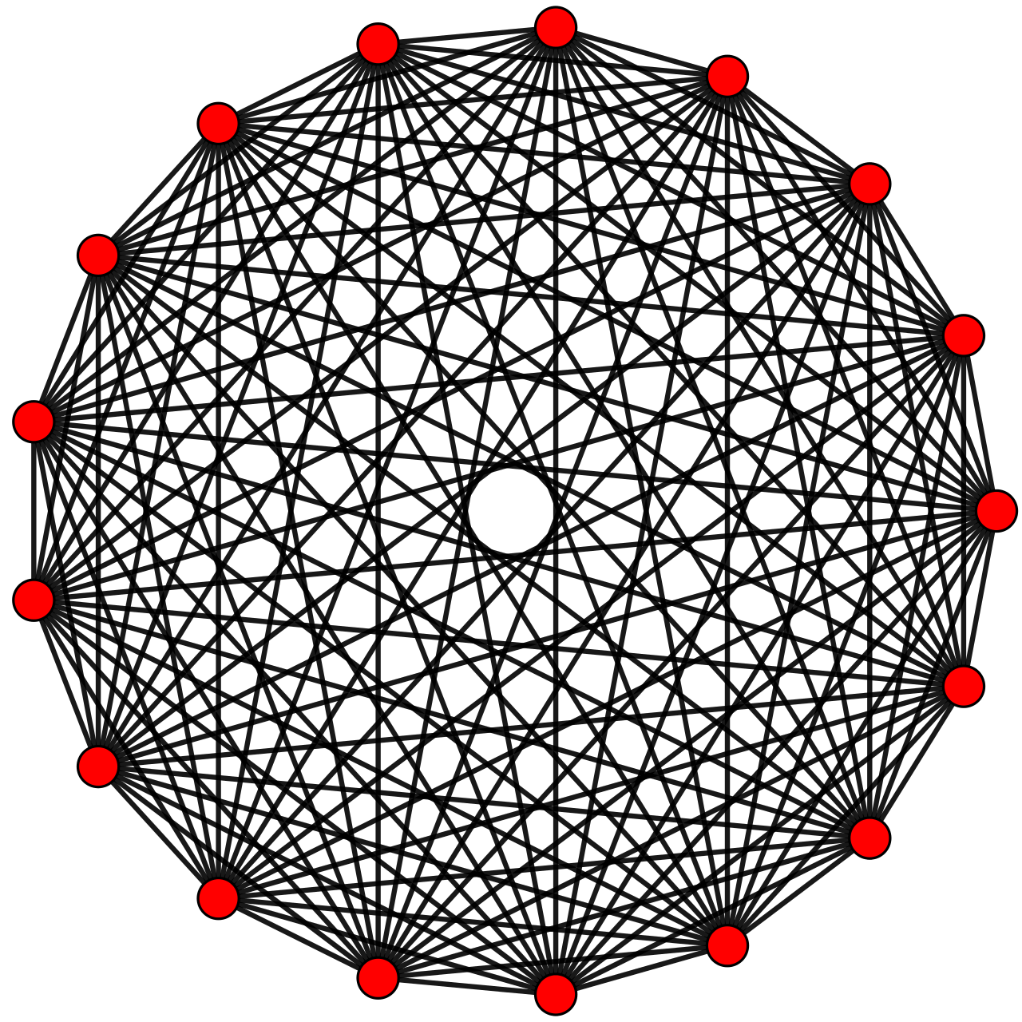
Approach
Weighted Undirected Graph
Each SDG is represented by a vertex
Each vertex is connected to every other by an edge
Edges represent the correlation strength (-1 to 1) between vertices
The vertices each contain an achievement score from 0 to 1
Notes:
Madison
We utilized a weighted undirected graph where each edge corresponds to a correlation between two nodes
Each node represents the individual sustainability goals
The connections were determined based on correlations due to a lack of specific causation data that we found within our time frame
Correlation strengths ranged from -1 to 1 and achievement score ranges from 0 to 1
Achievement score is a measure of the achievement of each node. Our initial values are based on data directly from the UN (used worldwide averages to create a global approach rather than focusing on one specific region.

Slide 4
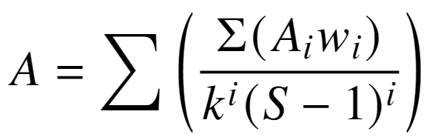
Algorithm Intuition: Achievement Score
Reverse wave propagation
“Lifted cloth” metaphor
Superposition with both constructive and destructive interference
Notes:
Erick White

Slide 5
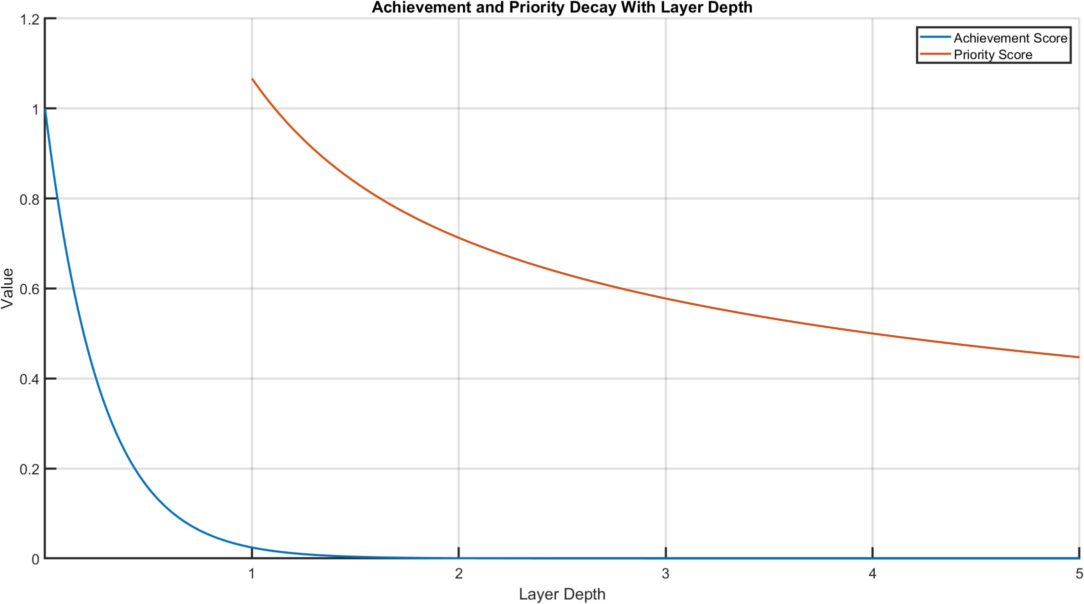
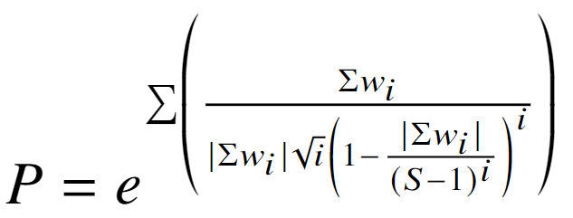
Algorithm Intuition: Priority
Exponent used to keep priorities positive
Wave model
Notes:
Erick White

Slide 6
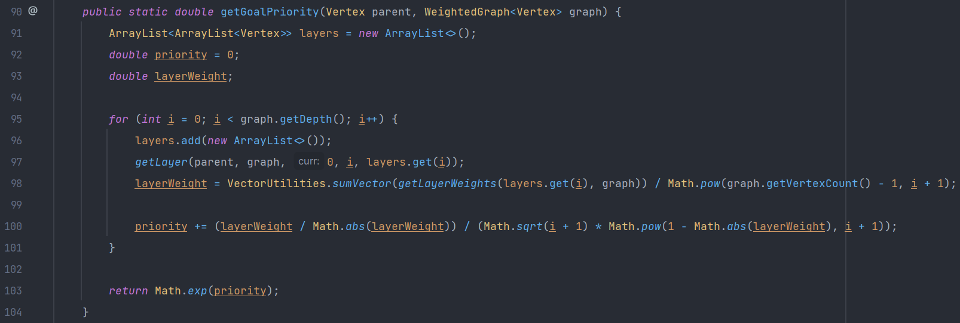
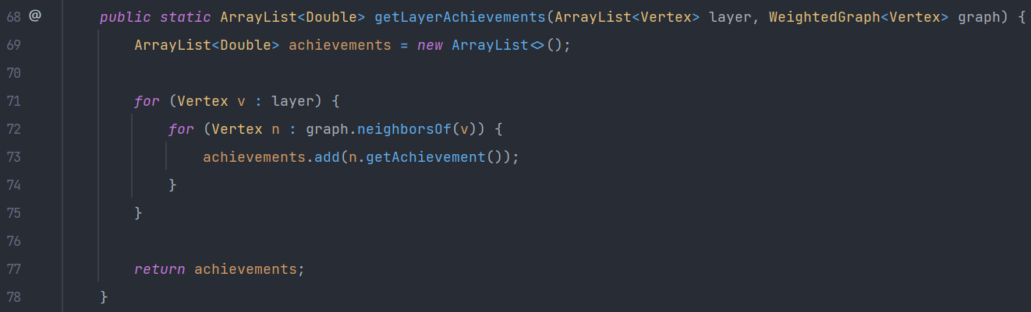
Algorithm Implementation
Generic weighted graph implementation
Custom vertex data type
Gather vertices into “layers”
Notes:
Erick White

Slide 7
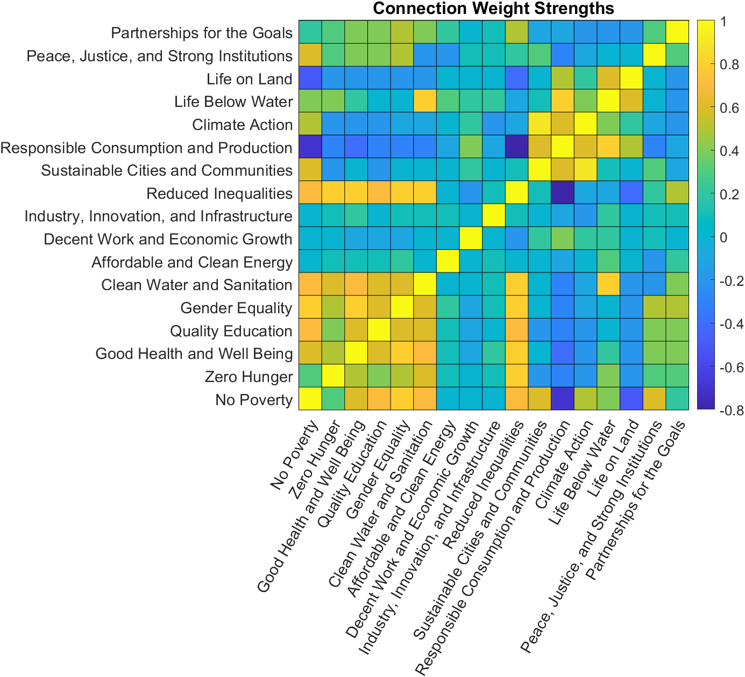
Edge Weights
Each goal has its own sub-targets, which can be compared to determine the relationships as each goal is completed
Weights range from -1 to 1
Some weights are equal to zero
Represent unrelated goals
Symmetry along y=x is due to the undirected nature of the graph
Notes:
Liz

Slide 8
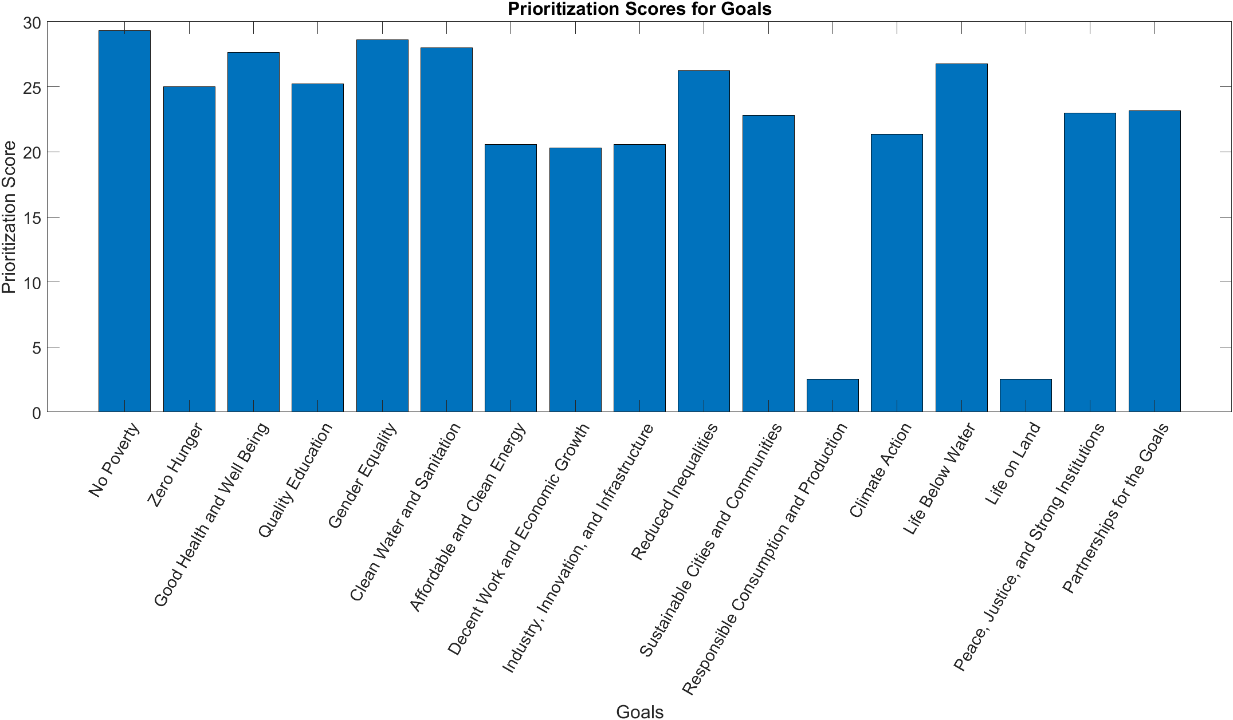
Vertex Priorities
Each vertex (goal) has an associated priority score
Related to priorities between goals
Positive values only
Demonstrates the impacts of the weights between nodes through propagation
Notes:
Priorities

Slide 9
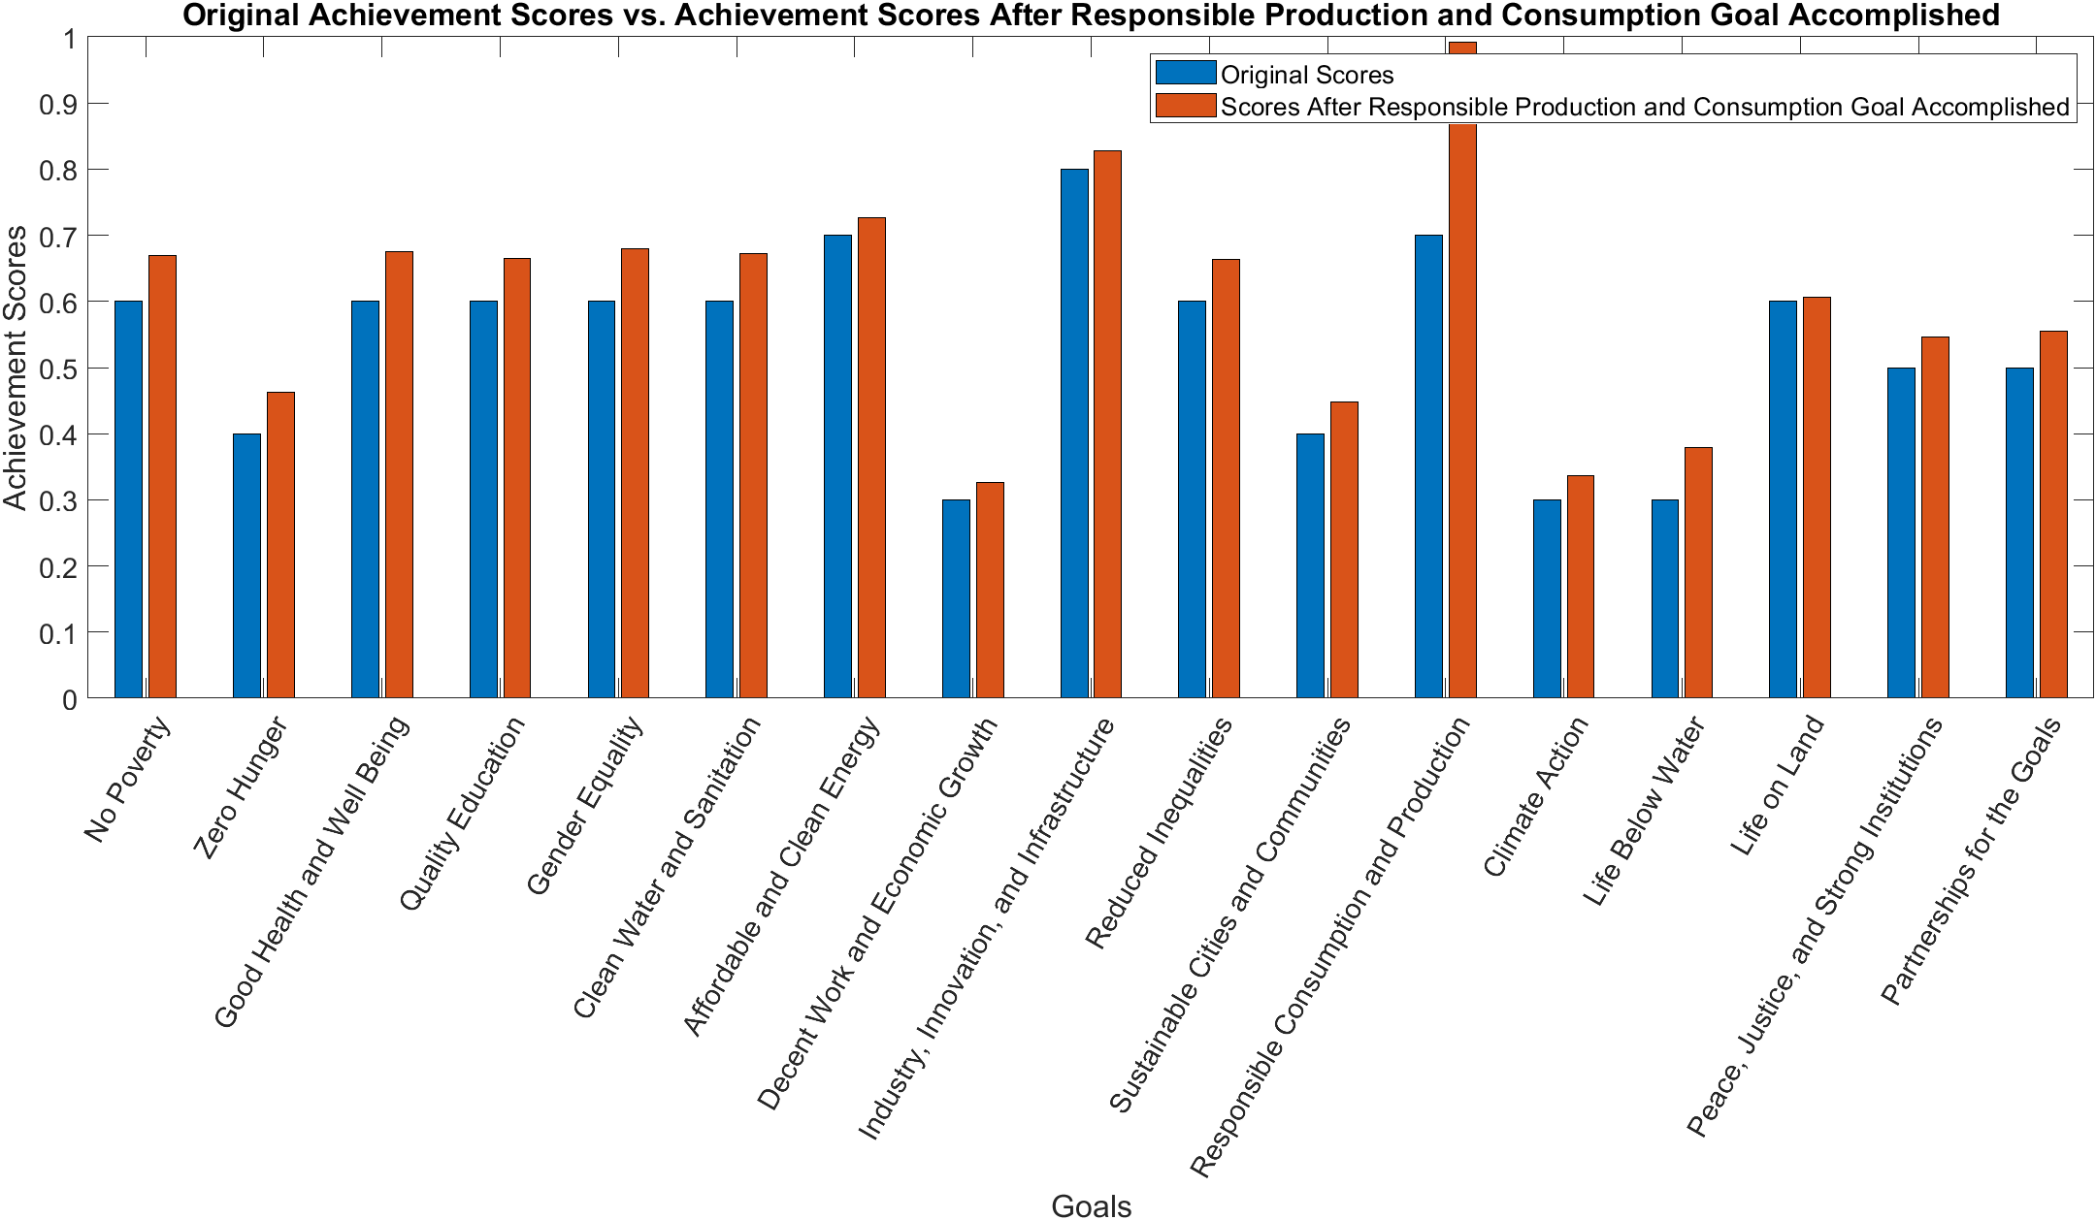
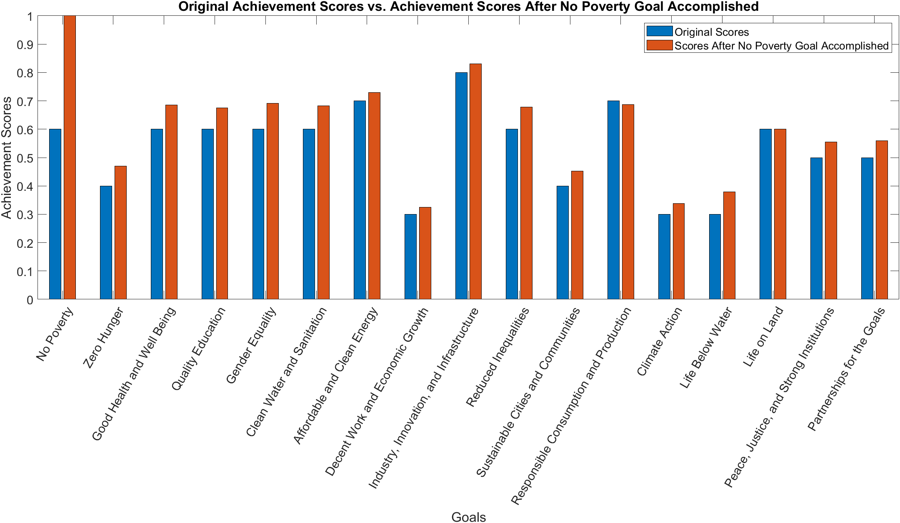
Most Positive/Negative Impacts
SDG 1: No Poverty holds the most positive impact
SDG 12: Responsible Consumption and Production holds the most negative impact
Notes:
Liz

Slide 10
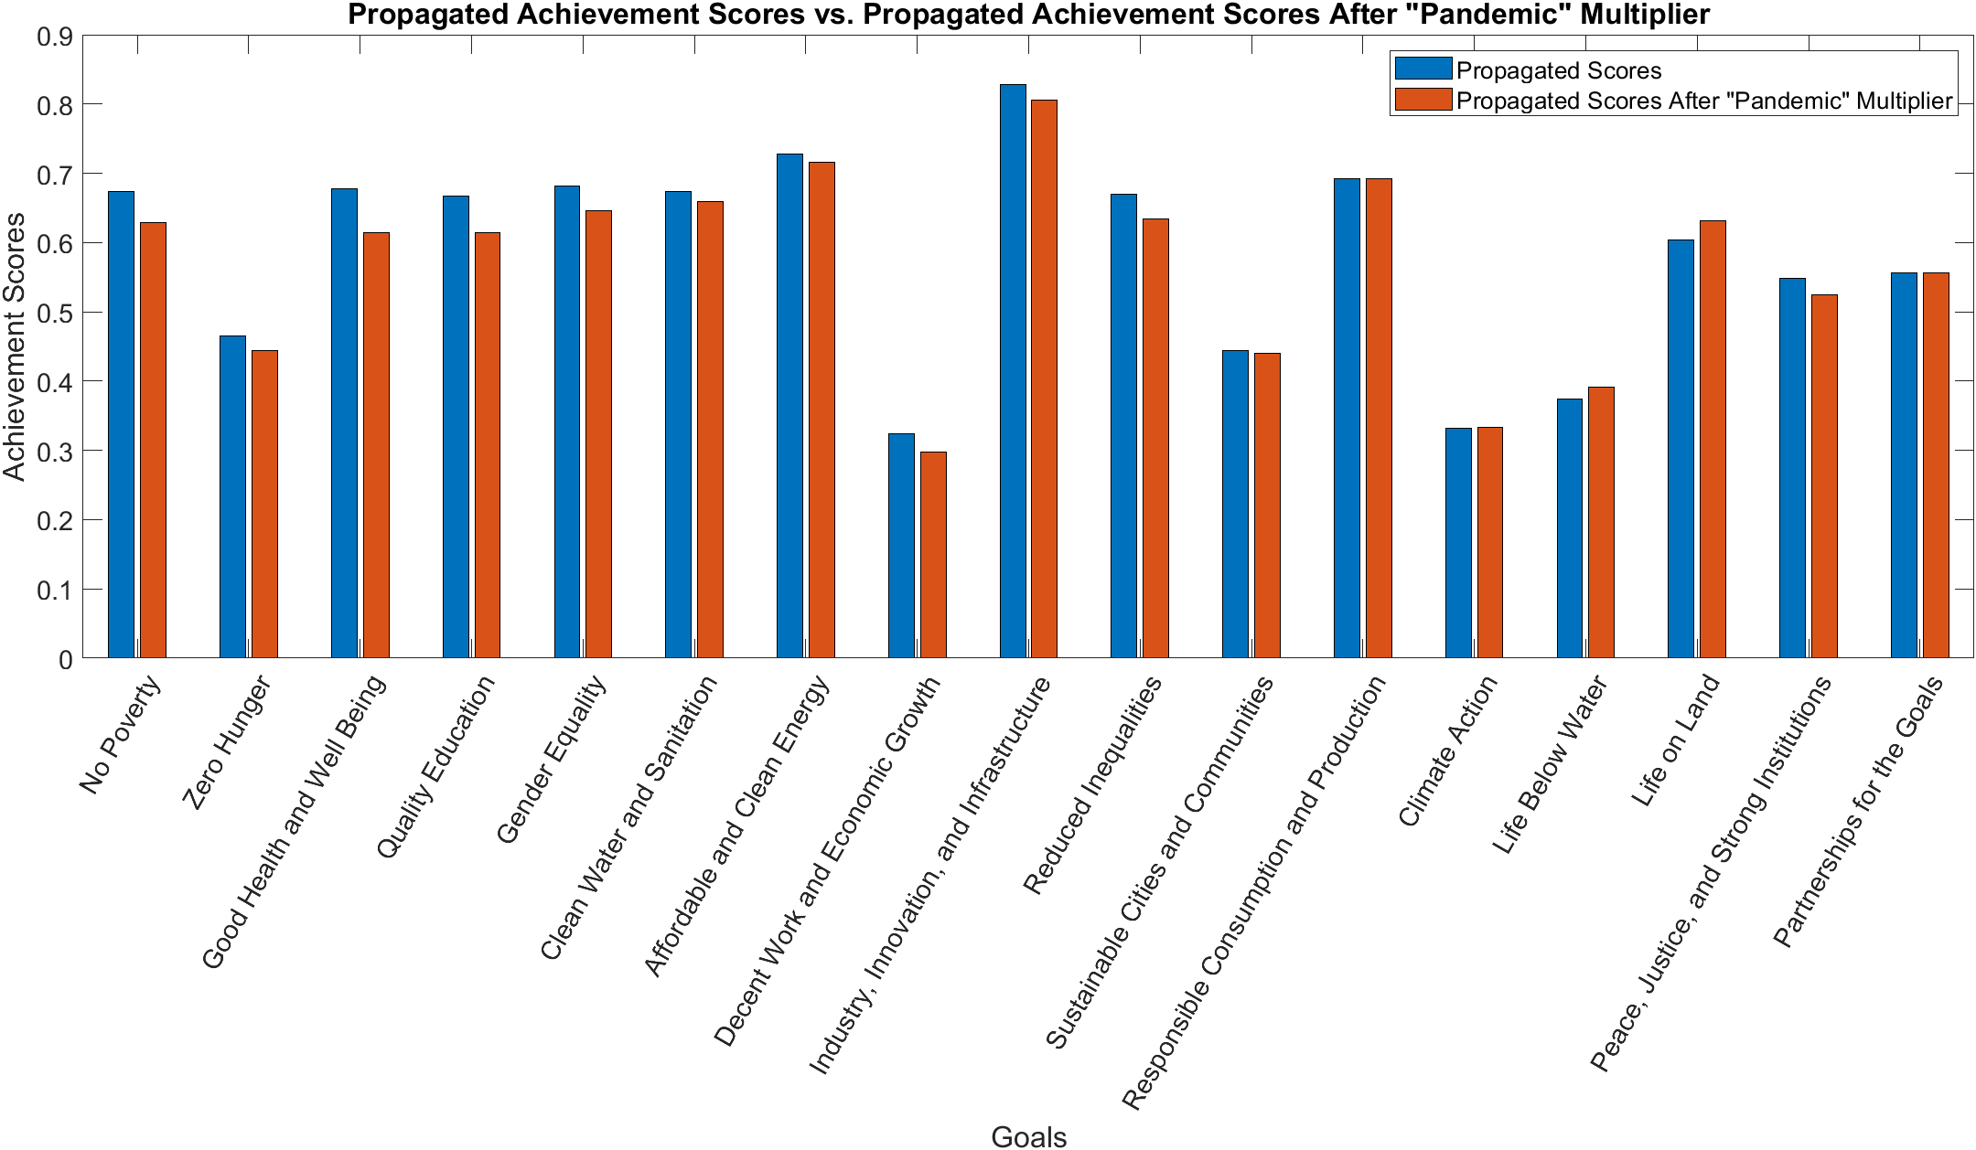
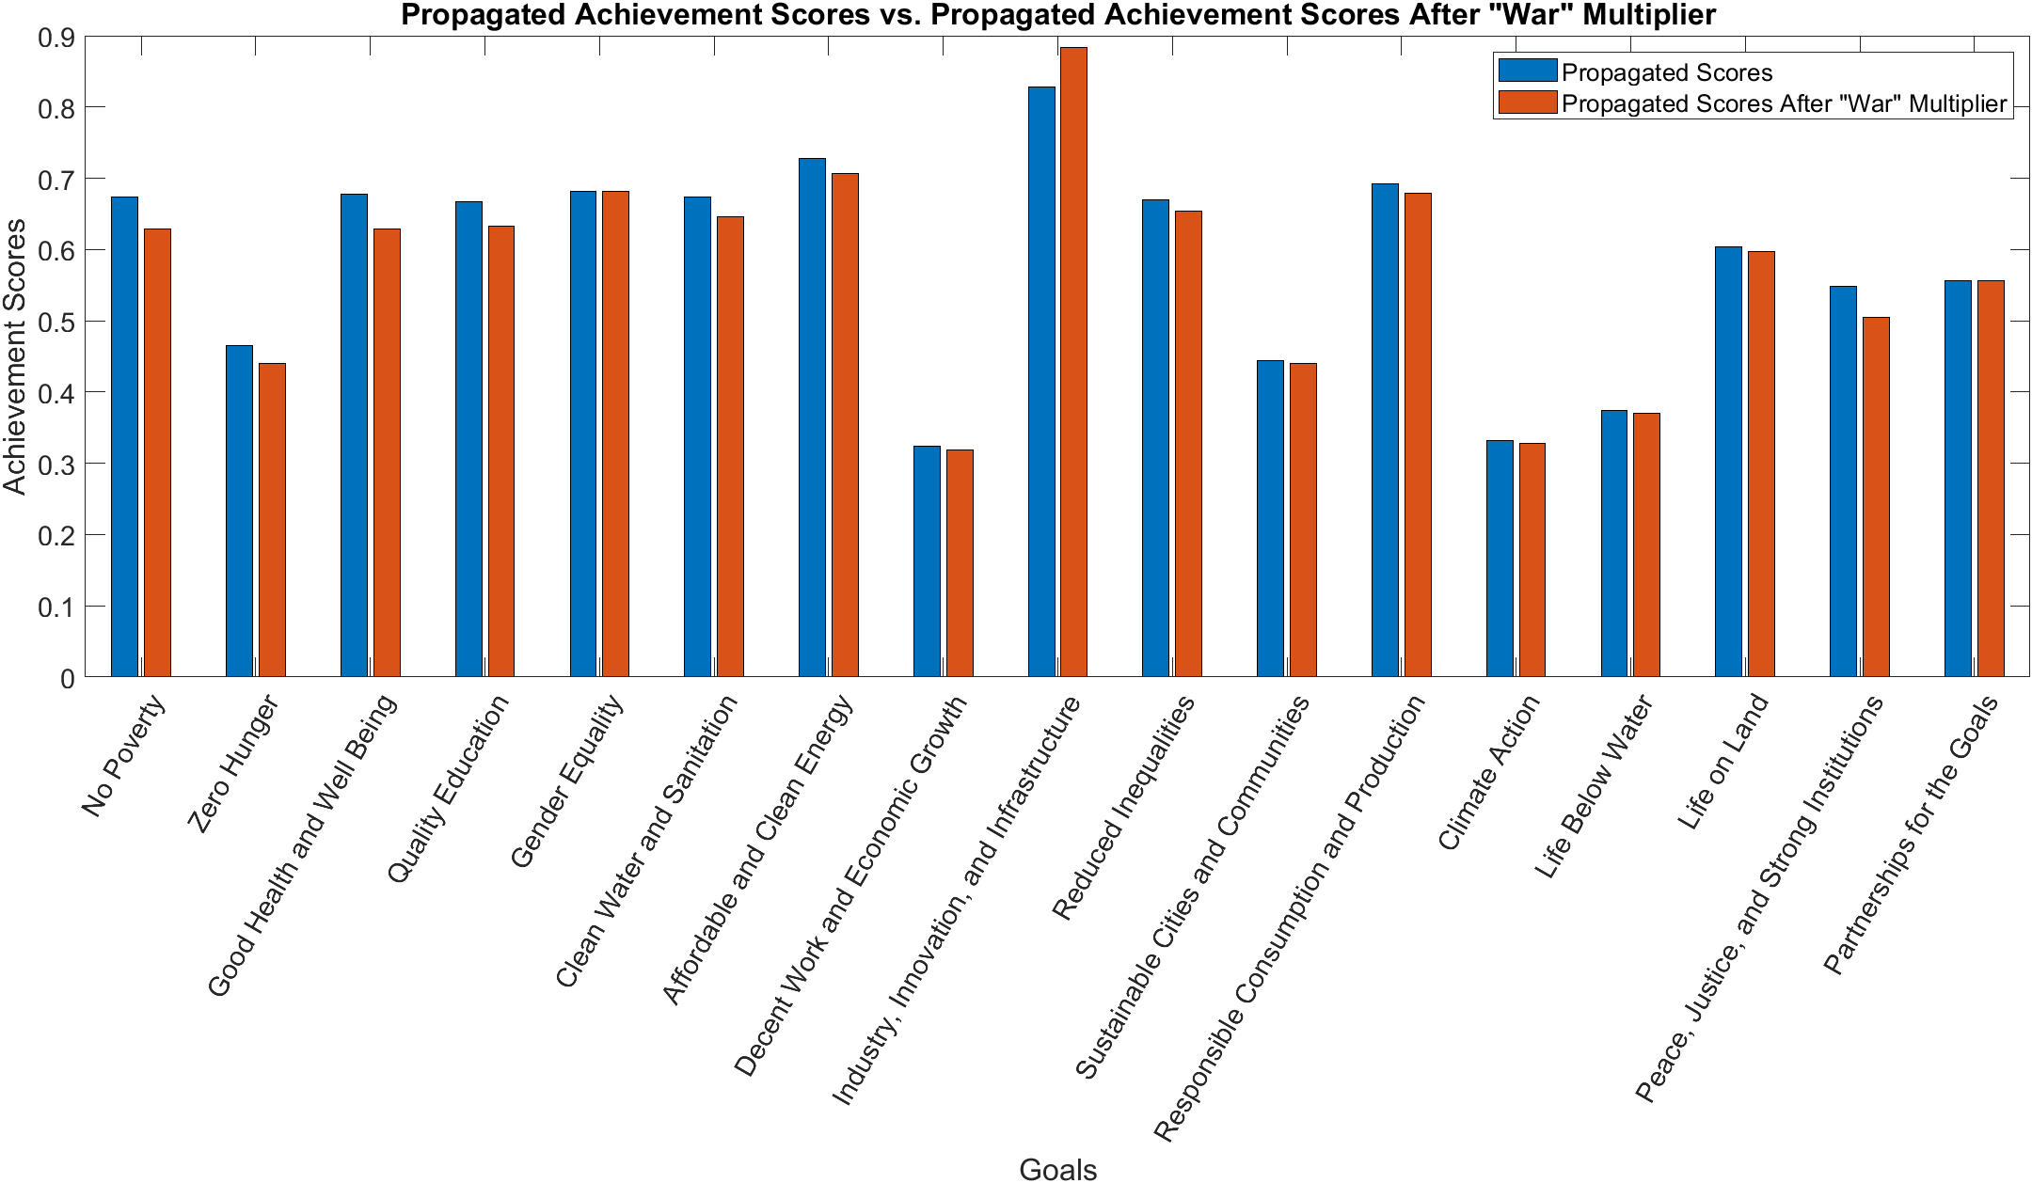
Graphs – Pandemics and Wars
Notes:
Madison
Multiplier scale
For war we made use of data from the war in Yemen, the war in Ukraine, and the impacts of the war in Ukraine on Africa.
Different data sources allowed us to extrapolate correlational impacts.
From data from the UN, we used the conflict attributable differences for the war in Yemen
War most negatively impacted sdg 1 (no poverty), sdg 3(good health and well being) and sdg 16 (peace, justice, and strong institutions)
SDG 1 and 3 have strong correlations and sdg 1 and 16 have a strong correlation
Gender equality and partnership for the goals are minimally correlated with war
Industry innovation and infrastructure has a positive correlation with war
For the pandemic, we studied the effects of the covid 19 pandemic on the sdgs
Current trend lines and extrapolated results
Detrimental to good health and well being, quality education, and decent work and economic growth
May have positive progress for life below water and life on land

Slide 11
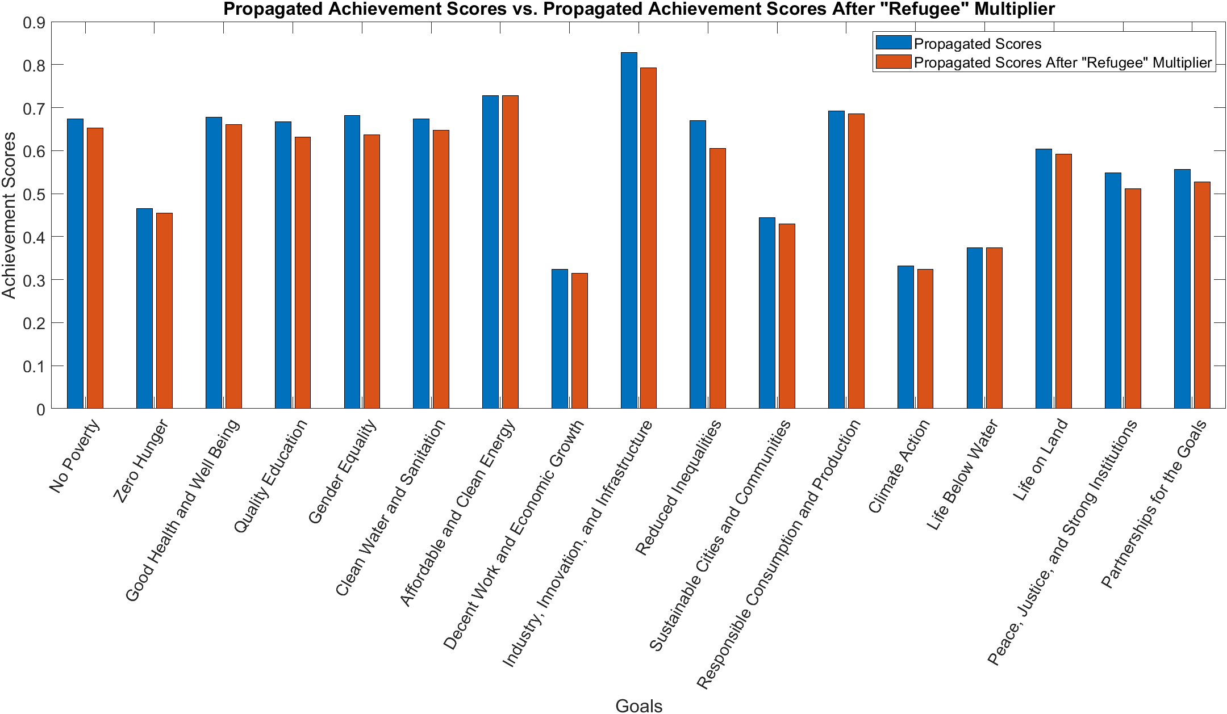
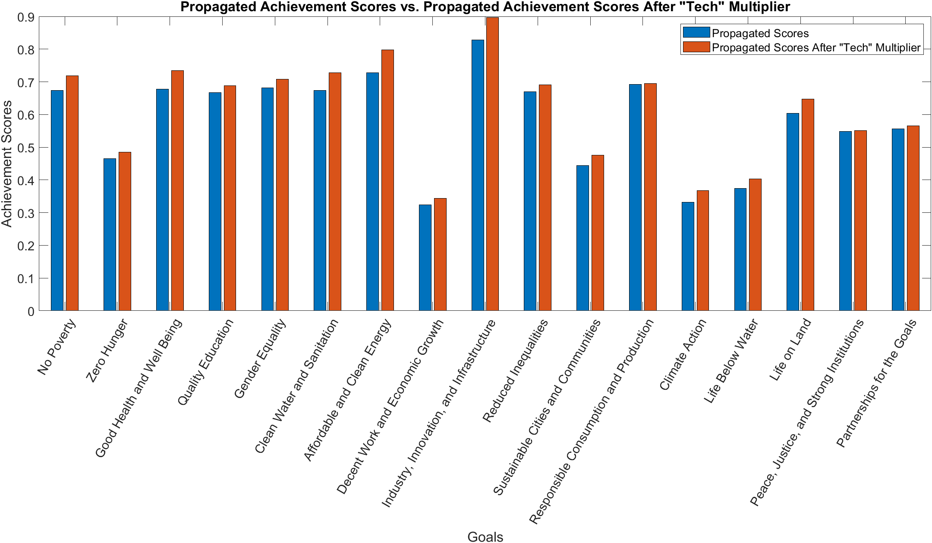
Graphs – Refugee Movements and Technological Advancements
Notes:
Madison

Slide 12
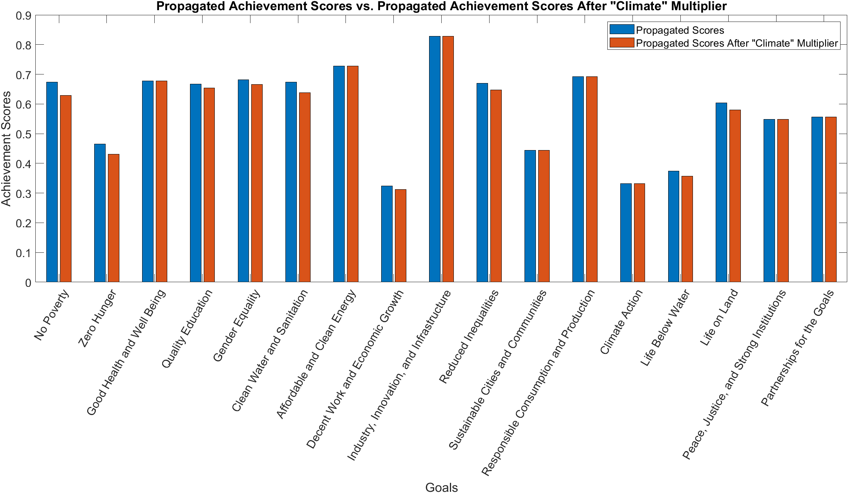
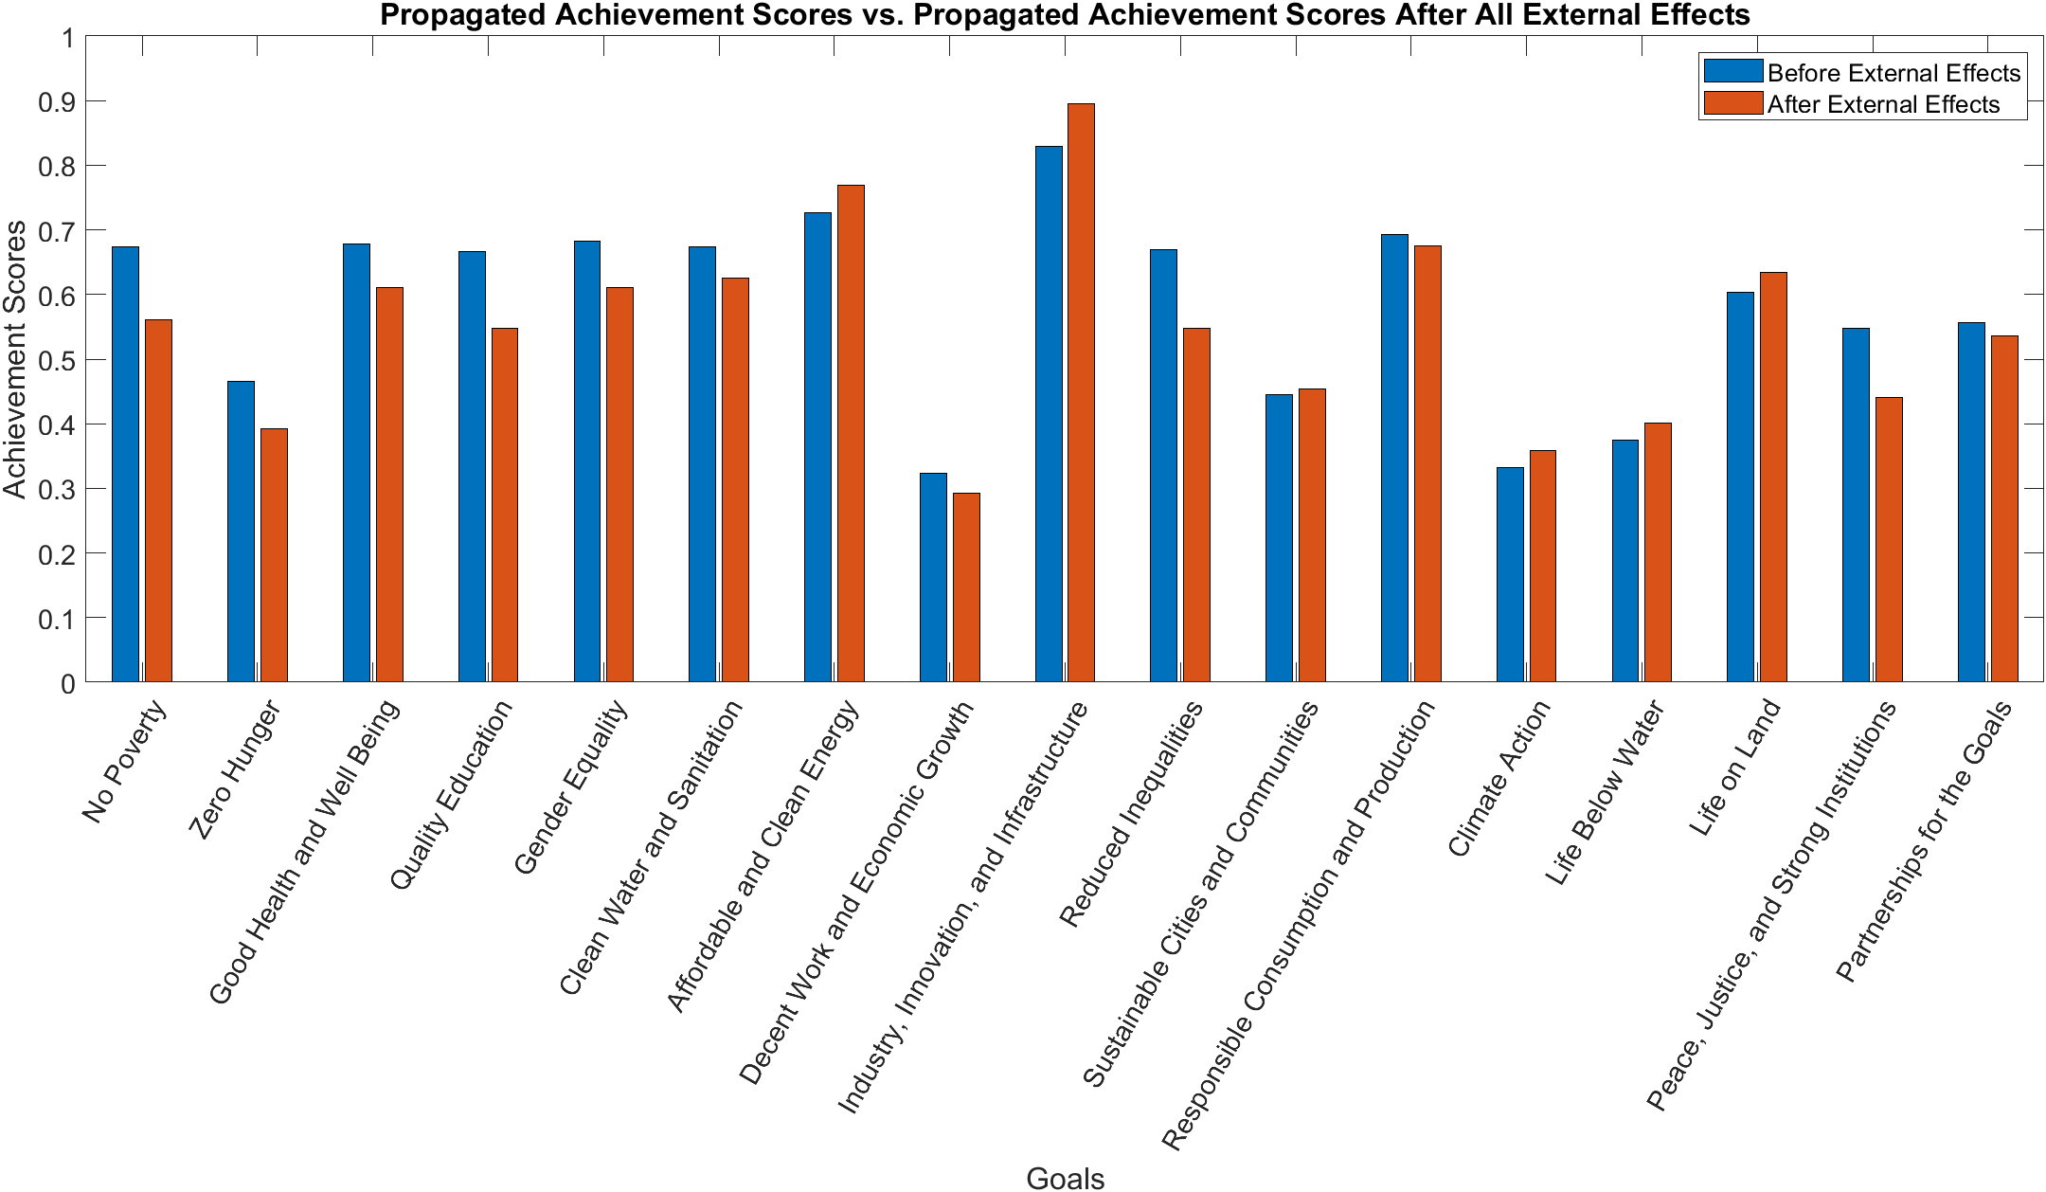
Graphs – Climate Change and All External Effects
Notes:
Madison

Slide 13
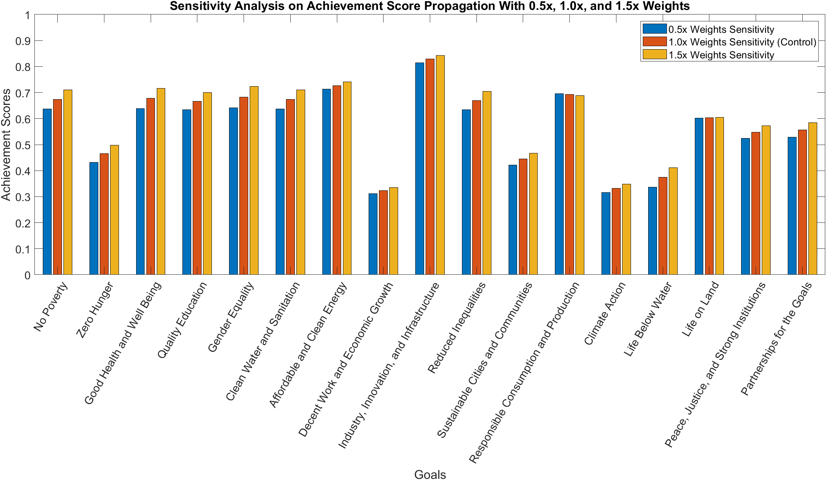
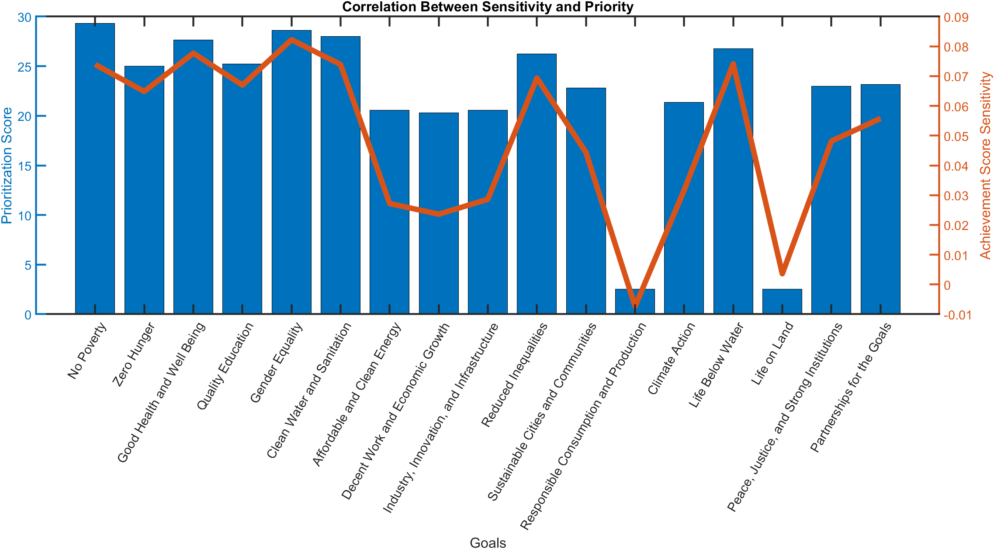
Sensitivity Analysis
Notes:
Erick

Slide 14
Questions?
Thank You!

